Slide 1


Detecting Fraudulent Transactions Using Machine Learning
A Data Mining Solution for Secure Bank Financial Services
Team Number: Group 4
Team Members:
Elton Ferreira (100902266)
Maisha Khatoon ( 100899259)
Raghav Kaushik (100950718)

Slide 2
Secure Bank Financial Services
Background:
Secure Bank Financial Services is a leading financial institution known for its customer-centric approach and advanced digital banking solutions. It offers millions of customers worldwide a wide range of services, including personal banking, loans, and investment products.
Problem Addressed:
Rise in Fraudulent Transactions: With the increasing digitization of financial services, Secure Bank is experiencing a growing number of fraudulent transactions. These activities pose significant risks, including economic losses, reputational damage, and compromised customer trust.

Slide 3
Business problem/ opportunity
Stakeholders
Customers: Expect secure and reliable banking services.
Bank Management: Seeks to protect financial assets and reputation.
Security Teams: Tasked with preventing and detecting fraudulent activities.
Challenges
Fraud Detection: Secure Bank faces the challenge of identifying fraudulent transactions effectively without impacting legitimate transactions.
Accuracy vs. Efficiency: Balancing the need for accurate fraud detection with fast transaction processing.
Resource Allocation: Efficiently allocating resources to monitor and investigate potential fraud cases.
Opportunities
Improved Detection: By leveraging advanced data mining techniques, Secure Bank can enhance its fraud detection capabilities.
Cost Reduction: Reducing financial losses associated with fraud can lead to significant cost savings.
Humanity considerations
Privacy: Ensuring that fraud detection methods respect customer privacy and data protection regulations.
Transparency: Maintaining transparency with customers about the bank's efforts to combat fraud.

Slide 4

Data mining problem
Type of Problem
Supervised Learning: The problem is addressed using supervised learning techniques where the model learns to predict the class of a transaction (fraudulent or legitimate) based on historical data.
Approach
Predictive Modeling: The goal is to build a predictive model that can classify transactions as fraudulent or non-fraudulent with high accuracy.
Classification Task: The model categorizes transactions into two classes—fraudulent (1) and legitimate (0).
Deployment
Integration into Transaction Monitoring System: The model will be deployed in Secure Bank's existing transaction monitoring system to enable real-time fraud detection.
Scalable Architecture: Ensure the model can handle large volumes of transactions and adapt to changing fraud patterns.
Continuous Learning: Implement mechanisms for ongoing model retraining with new data to maintain accuracy and effectiveness.
Tools and Techniques
Machine Learning Algorithm: XGBoost Classifier is used due to its efficiency and accuracy in handling large datasets and complex patterns.
Hyperparameter Tuning: Grid search and cross-validation techniques are employed to optimize model parameters.

Slide 5

Data Description
Data Source
Secure Bank Financial Services: Transactional data collected from the bank's internal systems.
Dataset Overview
Total Records: 14,247 transactions
Total Features: 11 features
Key Features/ Columns
step, type, amount, nameOrig, oldbalanceOrg, newbalanceOrig, nameDest, oldbalanceDest, newbalanceDest, isFraud, isFlaggedFraud: Indicator if the transaction is flagged as potentially fraudulent.
Data Characteristics
Imbalance: The dataset is highly imbalanced with a small percentage of fraudulent transactions.
Missing Values: Some features have missing values that need to be addressed.
Diverse Transaction Types: Includes multiple transaction types, each with distinct patterns of behavior.
Data Format
Numeric Features: Amount, balances, and steps.
Categorical Features: Transaction type, origin, and destination identifiers.

Slide 6

Data Cleansing
Steps Taken
Handling Missing Values
Identified Missing Values: Detected in features such as oldbalanceOrg, newbalanceOrig, nameDest, oldbalanceDest, newbalanceDest, and isFraud.
Approach: Imputed missing values using statistical methods (e.g., mean/mode for numerical features). Dropped rows with critical missing values that could not be reliably imputed.
Addressing Imbalance
Class Imbalance: Significant imbalance between fraudulent and legitimate transactions.
Approach: Employed techniques like SMOTE (Synthetic Minority Over-sampling Technique) to create a balanced training dataset.
Encoding Categorical Variables
Features Encoded: type, nameOrig, nameDest.
Approach: Used label encoding for account identifiers and one-hot encoding for transaction types to convert categorical data into numerical form suitable for model input.
Challenges
Imbalanced Data: Ensuring the model learned from both classes without being biased towards the majority class.
Data Quality: Ensured accuracy in handling missing values and encoding to maintain data integrity.
Tools Used
Python Libraries: Utilized Pandas for data manipulation and Scikit-learn for preprocessing tasks.
Data Exploration: Employed exploratory data analysis (EDA) techniques to identify patterns and anomalies.

Slide 7

Methods
Machine Learning Model
XGBoost Classifier: Chosen for its High accuracy and efficiency. Ability to handle large datasets with complex patterns. Robustness against overfitting through regularization parameters.
Hyperparameter Tuning
Grid Search and Cross-Validation: Parameters Tuned: Learning rate, Maximum depth, Subsample ratio, Column sample by tree.
Feature Engineering
Encoding Categorical Features: Applied label encoding and one-hot encoding to convert categorical variables into numerical format.
Feature Importance Analysis: Used XGBoost's built-in feature importance function to identify the most significant features contributing to fraud detection.
Model Training and Validation
Data Splitting: Training and Validation Sets: Split the data into training and validation sets to evaluate model performance.
Evaluation Metrics: ROC-AUC: Used as the primary metric for evaluating model performance.
Confusion Matrix: Analyzed precision, recall, and F1-score to understand model effectiveness.

Slide 8

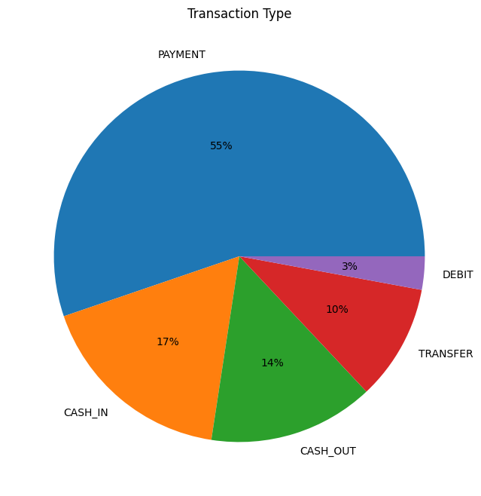
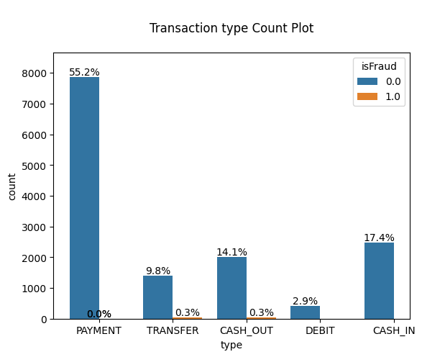
Visualizations

Slide 9

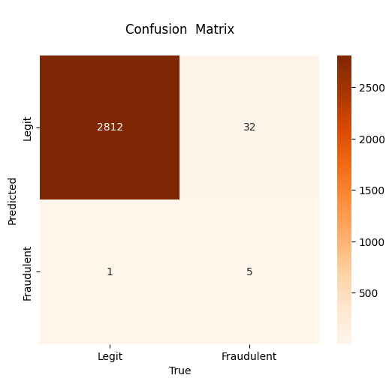
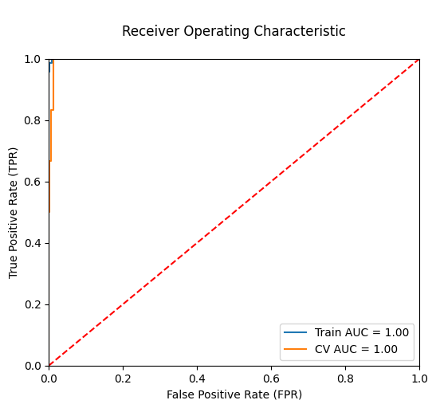
Results
Confusion Matrix & Receiver Operating Characteristic
Confusion Matrix: The Confusion Matrix in our results shows how well the model predicts fraudulent transactions, detailing true positives, true negatives, false positives, and false negatives. This helps us assess the model’s accuracy and identify areas where it might misclassify transactions.
ROC Curve: The ROC Curve from our results illustrates the trade-off between the true positive rate and the false positive rate at various thresholds. The Area Under the Curve (AUC) indicates the model's effectiveness in distinguishing between fraudulent and legitimate transactions, with a higher AUC reflecting better performance.

Slide 10
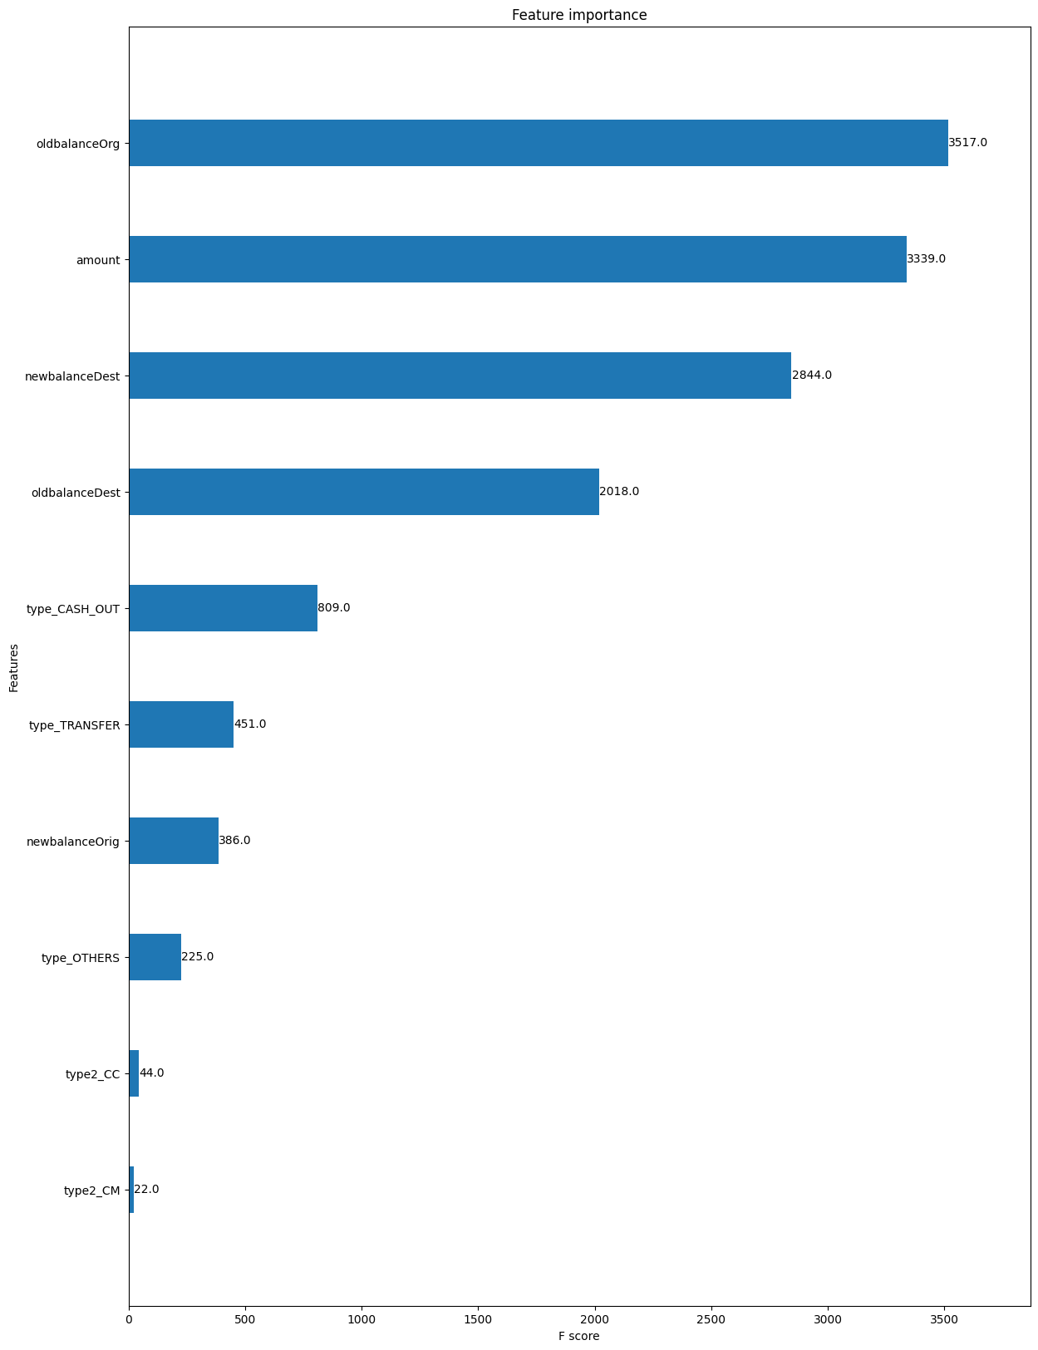
Results
Feature Importance: The Feature Importance analysis in our results highlights the key factors that the model relies on to predict fraudulent transactions. By ranking the features based on their impact on the model's decisions, we can identify which variables contribute most to accurate predictions. This insight is crucial for understanding the underlying drivers of fraud and can guide further data-driven decisions.

Slide 11
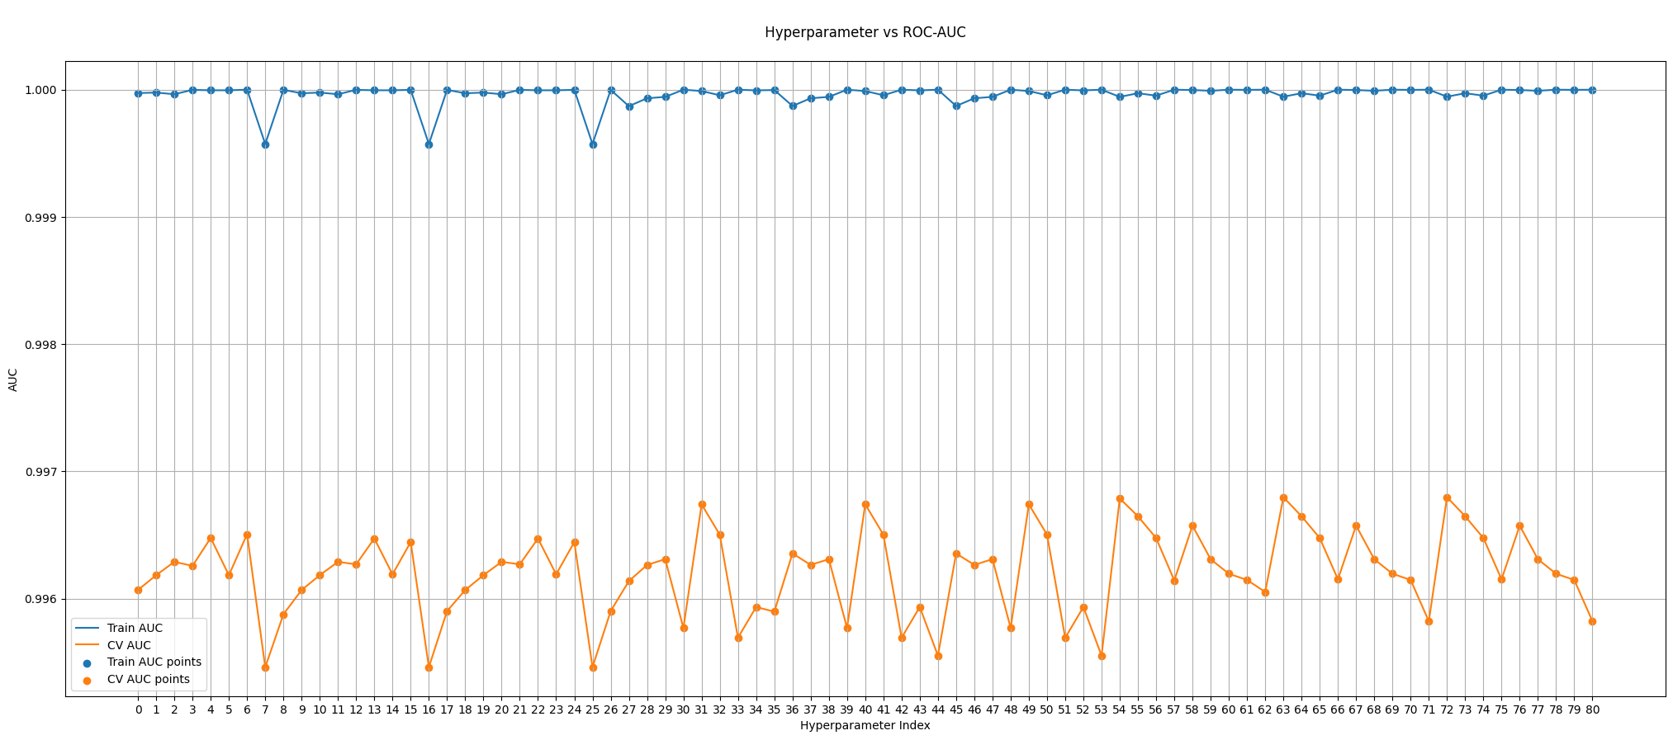
Results
Hyperparameters: Hyperparameters control the model's learning process, directly influencing its performance.
ROC-AUC: ROC-AUC measures the model's ability to distinguish between classes, guiding the selection of optimal hyperparameters. In short, hyperparameters shape the model, and ROC-AUC evaluates the quality of the results.

Slide 12

Model Evaluation
Evaluation Metrics
ROC-AUC (Receiver Operating Characteristic - Area Under Curve)
Purpose: Measures the model's ability to distinguish between fraudulent and legitimate transactions.
Result: Achieved a high ROC-AUC score, indicating strong model performance.
Confusion Matrix
Components: True Positives, False Positives, True Negatives, and False Negatives.
Analysis: Focused on maximizing True Positives (correctly identified frauds) and minimizing False Positives (legitimate transactions incorrectly identified as fraud).
Precision and Recall
Precision: Proportion of true positive results in all positive predictions.
Recall: Proportion of true positive results in all actual positive cases.
F1-Score: Harmonic mean of precision and recall, used to balance the trade-off between them.
Benchmark and Comparison
Baseline Model: Compared XGBoost performance with a baseline logistic regression model.
Baseline Results: Significantly lower ROC-AUC and precision-recall metrics.
XGBoost Advantage: Demonstrated superior performance in capturing complex patterns associated with fraud.
Model Validation
Cross-Validation: Used 3-fold cross-validation to ensure the model's robustness and consistency across different subsets of data.

Slide 13

Implications
Business Implications
Enhanced Fraud Detection: The implementation of the XGBoost model significantly improves the accuracy and speed of fraud detection, enabling real-time intervention.
Cost Savings: By reducing false positives and false negatives, the bank can minimize financial losses associated with undetected fraud and avoid unnecessary investigations of legitimate transactions.
Customer Trust: Reliable fraud detection enhances customer confidence in Secure Bank's ability to protect their assets, fostering long-term relationships.
Operational Implications
Resource Allocation: Automation of fraud detection allows security teams to focus on complex cases, optimizing resource allocation and operational efficiency.
Scalable Solution: The model can easily scale to accommodate increasing transaction volumes, ensuring continued efficacy as the bank grows.
Strategic Implications
Competitive Advantage: Advanced fraud detection capabilities differentiate Secure Bank from competitors, offering a key selling point to attract new customers.
Regulatory Compliance: Enhanced detection aligns with regulatory requirements for anti-fraud measures, reducing the risk of penalties and enhancing the bank's reputation.
Organizational Impact
Data-Driven Decision Making: Insights from the model provide valuable data-driven guidance for strategic planning and decision-making across the organization.

Slide 14

Recommendations
Ongoing Monitoring and Maintenance
Continuous Model Updates: Regularly update the model with new data to capture evolving fraud patterns and maintain accuracy.
Performance Monitoring: Implement a robust monitoring system to track model performance and identify any drift in prediction accuracy.
Data Quality and Collection
Enhanced Data Collection: Encourage collection of additional features such as transaction metadata (e.g., IP addresses, device information) for deeper insights.
Data Quality Assurance: Implement processes to ensure the accuracy and completeness of data inputs, reducing noise and improving model reliability.
Addressing Potential Bias
Bias Audits: Conduct regular audits to ensure the model does not disproportionately flag transactions based on irrelevant factors such as customer demographics.
Fairness Enhancements: Explore techniques to improve model fairness and mitigate any detected biases, ensuring equitable treatment of all customers.
Strategic Partnerships
Collaboration with Security Experts: Partner with cybersecurity experts to refine detection strategies and stay ahead of emerging threats.
Industry Collaboration: Engage with other financial institutions to share insights and best practices for fraud prevention.
Future Research and Development
Exploration of Alternative Models: Investigate the potential of other advanced models, such as neural networks, to further enhance detection capabilities.
Scenario Analysis: Conduct scenario analysis to understand the impact of different fraud patterns and improve preparedness for diverse threats.

Slide 15


